Slide 1
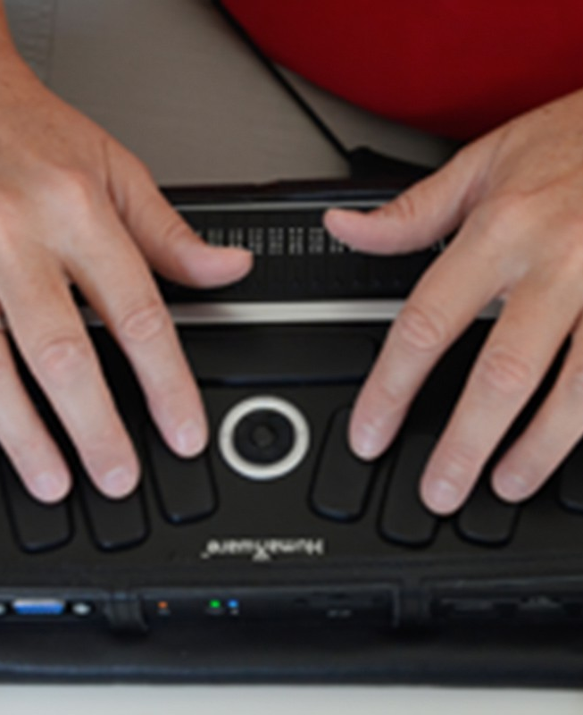
Assistive Device for Blind, Deaf and Dumb
Submitted by:
Dekka Sridhar (20BCS6174)
ISHIKA JAIN (20BCS6166)
MANDLEM BHAVYA VASAVI (20BCS6222)
DEMA BHARATH KUMAR (20BCG1125

Slide 2
Introduction Challenges Faced by Blind, Deaf and Dumb People What is Raspberry-pi? Assistive Device for Blind People Assistive Device for Deaf People Assistive Device for Dumb People Benefits of Assistive Devices using Raspberry-pi Conclusion

Slide 3
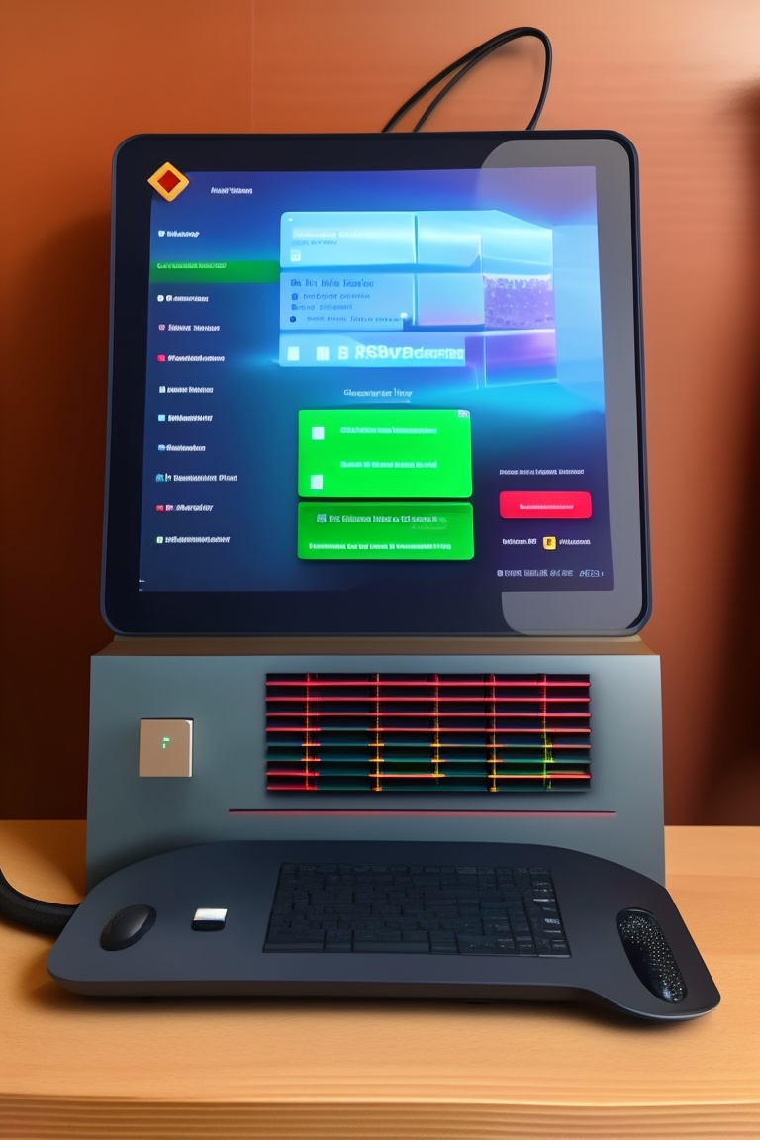
Introduction
Being challenged by conditions like blindness, hearing loss, or deafness is of increasing concern. Science and innovation have led people to become more reliant on comfort, yet there is a group of disadvantaged people who are striving to come up with a novel technique to make communication easier for them.
The World Health Organization estimates that there are 285 million blind individuals, 300 million people who are hard of hearing, and 1 million persons who are quiet around the world. Communication is a major issue for those who are blind, deaf, or dumb in daily life.In this presentation, we will discuss the challenges faced by people with disabilities and how assistive devices can help them overcome these challenges. We will also explore the exciting world of Raspberry-pi and how it can be used to create innovative and affordable assistive devices

Slide 4

Challenges Faced by Blind, Deaf and Dumb People
Living with a disability can be challenging, especially when it comes to basic tasks that most people take for granted. Blind, deaf and dumb people face unique challenges in their daily lives, such as communication barriers, mobility issues and difficulty accessing information. For example, blind people may have trouble navigating unfamiliar environments or reading printed materials, while deaf people may struggle to understand spoken language or hear alarms and alerts. Dumb people may have difficulty expressing themselves or understanding others. These challenges can lead to isolation, frustration and a lack of independence.
However, assistive devices can help people with disabilities overcome these challenges and live more fulfilling lives. For example, screen readers and braille displays can help blind people access digital content, while hearing aids and cochlear implants can improve hearing for deaf people. Speech recognition software and communication apps can help dumb people communicate more effectively. These devices not only improve quality of life, but also provide opportunities for education, employment and social engagement.

Slide 5
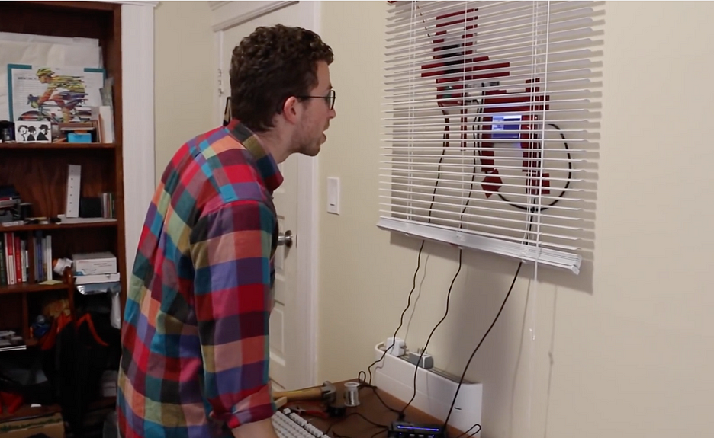
Assistive Device for Blind People
The Raspberry-pi can be used to create an assistive device for blind people that utilizes object detection and text-to-speech conversion. The device can detect objects within a certain range and provide audio feedback to the user, allowing them to navigate their surroundings with greater ease. Additionally, the device can convert written text into speech, enabling the user to read books or other printed material.
To demonstrate how the device works, we have prepared a video that shows the device in action. In the video, you can see the device detecting objects and providing audio feedback to the user. You can also see how the device converts written text into speech, making it easier for the user to access information.
These Raspberry Pi-Powered Smart Blinds Use Facial Detection to Open and Close

Slide 6
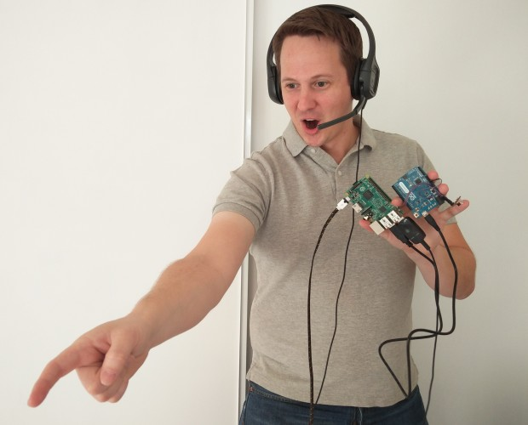
Assistive Device for Deaf People
Assistive devices have the ability to transform the lives of people with disabilities, and Raspberry-pi can be used to create innovative solutions that cater to specific needs. For deaf individuals, speech-to-text conversion and vibration alerts can be incredibly helpful features. These features allow for text-based communication in real-time, making it easier to stay connected with friends, family, and colleagues.
The device works by using a microphone to pick up speech, which is then converted into text using software. The text is then displayed on a screen or sent as a message to another device. Vibration alerts can also be added to notify the user when a new message has been received. This feature is particularly useful in noisy environments where auditory alerts may not be heard.
voice control of a domestic vacuum-robot using an Arduino and Raspberry Pi

Slide 7
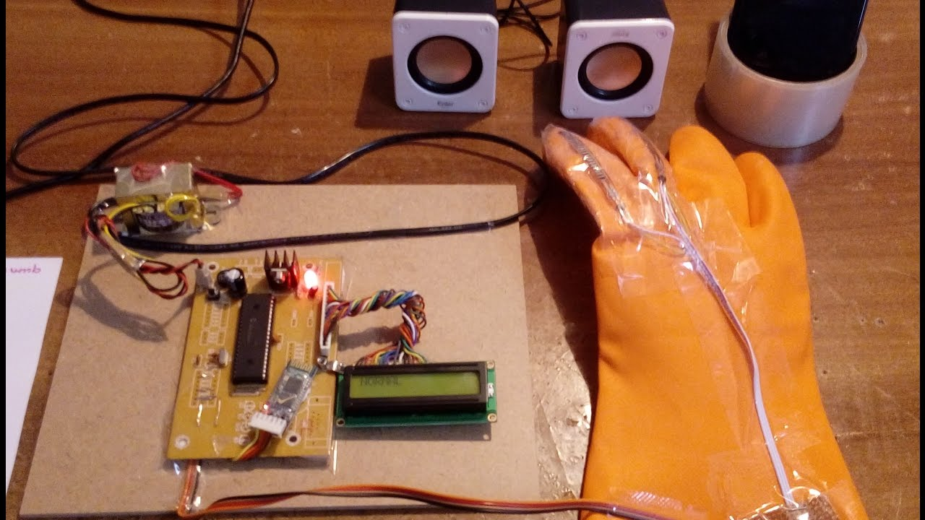
Assistive Device for Dumb People
One of the assistive devices that can be created using Raspberry-pi is a device for people who are unable to communicate verbally. This device can help them communicate through text-to-speech conversion and gesture recognition. The device can recognize hand gestures and convert them into words, allowing the user to communicate with others.
The text-to-speech feature allows the device to read out loud what the user types, making it easier for them to communicate with others. This device can be a life-changing invention for individuals who struggle with verbal communication.
Hand talk Assistive Technology for deaf and Dumb people

Slide 8
Benefits of Assistive Devices using Raspberry-pi
The use of Raspberry-pi in creating assistive devices has revolutionized the way we approach disability. These devices have made it possible for people with disabilities to live more independently, allowing them to perform tasks that would have been impossible without assistance. For example, a device that uses Raspberry-pi to convert text to speech can enable a visually impaired person to read books or surf the internet without needing someone else to help them.
Another benefit of using Raspberry-pi in creating assistive devices is the cost-effectiveness of these devices. Traditional assistive devices can be very expensive, making them inaccessible to many people who need them. However, Raspberry-pi is an affordable platform that can be used to create low-cost assistive devices that are just as effective as their more expensive counterparts.

Slide 9
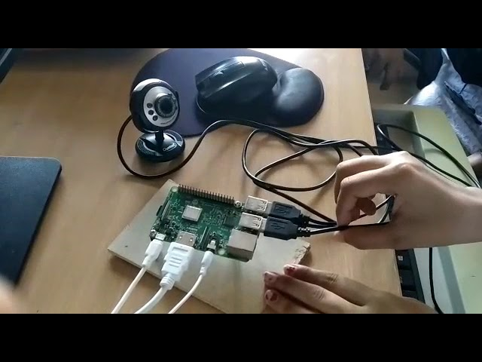
Conclusion
In conclusion, we have seen how assistive devices can greatly improve the lives of people with disabilities, particularly those who are blind, deaf, or dumb. With the help of Raspberry-pi, we can create innovative and affordable solutions that address their unique challenges and empower them to live more independently.
By leveraging the power of technology, we can bridge the gap between ability and disability, and make the world a more inclusive and accessible place for everyone. We hope that this presentation has inspired you to learn more about assistive devices and consider ways in which you can contribute to this important cause.
Assistive device for blink dump and deaf people using raspberry pi

